Slide 1



KARL: Fast Kernel Aggregation Queries
(Edison) Tsz Nam Chan^{1,2}, Man Lung Yiu², Leong Hou U³
¹Univ. of Hong Kong ²Hong Kong Polytechnic Univ. ³Univ. of Macau

Slide 2
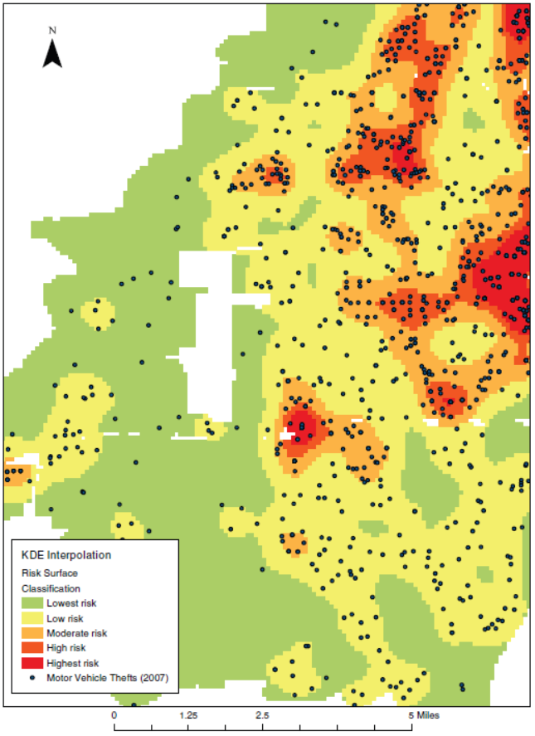
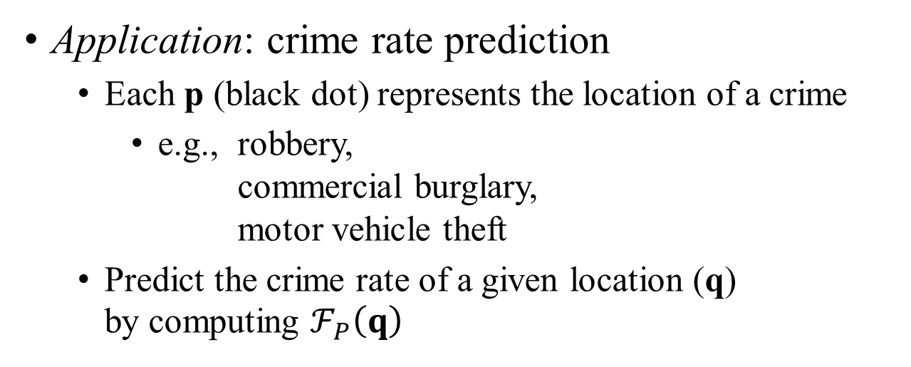
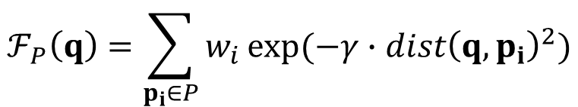
What is Kernel Aggregation?
query
weighting
Euclidean distance
Compute the function:
$$ℱ_{P}\left(q\right)=\sum_{p_{i}∈P}{w_{i}}exp⁡(−γ∙{dist\left(q,p_{i}\right)}^{2})$$
dataset
constant
Application: crime rate prediction
Each p (black dot) represents the location of a crime
e.g., robbery, commercial burglary, motor vehicle theft
Predict the crime rate of a given location (q) by computing $ℱ_{P}\left(q\right)$
T. Hart and P. Zandbergen “Kernel density estimation and hotspot mapping Examining the influence of interpolation method, grid cell size, and bandwidth on crime forecasting”, International Journal of Police Strategies and Management 2014

Slide 3
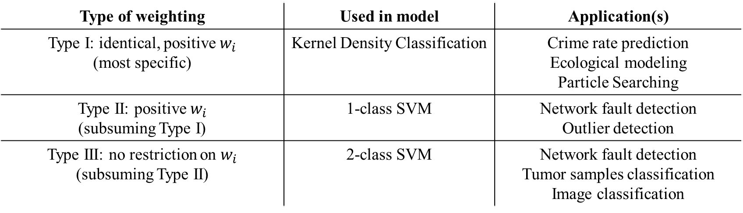
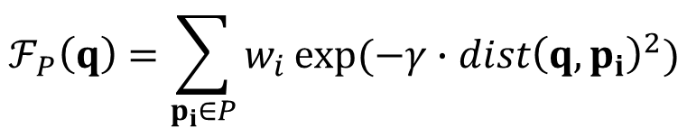
Kernel Aggregation: More Applications
query
weighting
Euclidean distance
Kernel aggregation function:
$$ℱ_{P}\left(q\right)=\sum_{p_{i}∈P}{w_{i}}exp⁡(−γ∙{dist\left(q,p_{i}\right)}^{2})$$
dataset
constant
Type of weighting | Used in model | Application(s)
Type I: identical, positive $w_{i}$ (most specific) | Kernel Density Classification | Crime rate prediction Ecological modeling Particle Searching
Type II: positive $w_{i}$ (subsuming Type I) | 1-class SVM | Network fault detection Outlier detection
Type III: no restriction on $w_{i}$ (subsuming Type II) | 2-class SVM | Network fault detection Tumor samples classification Image classification

Slide 4
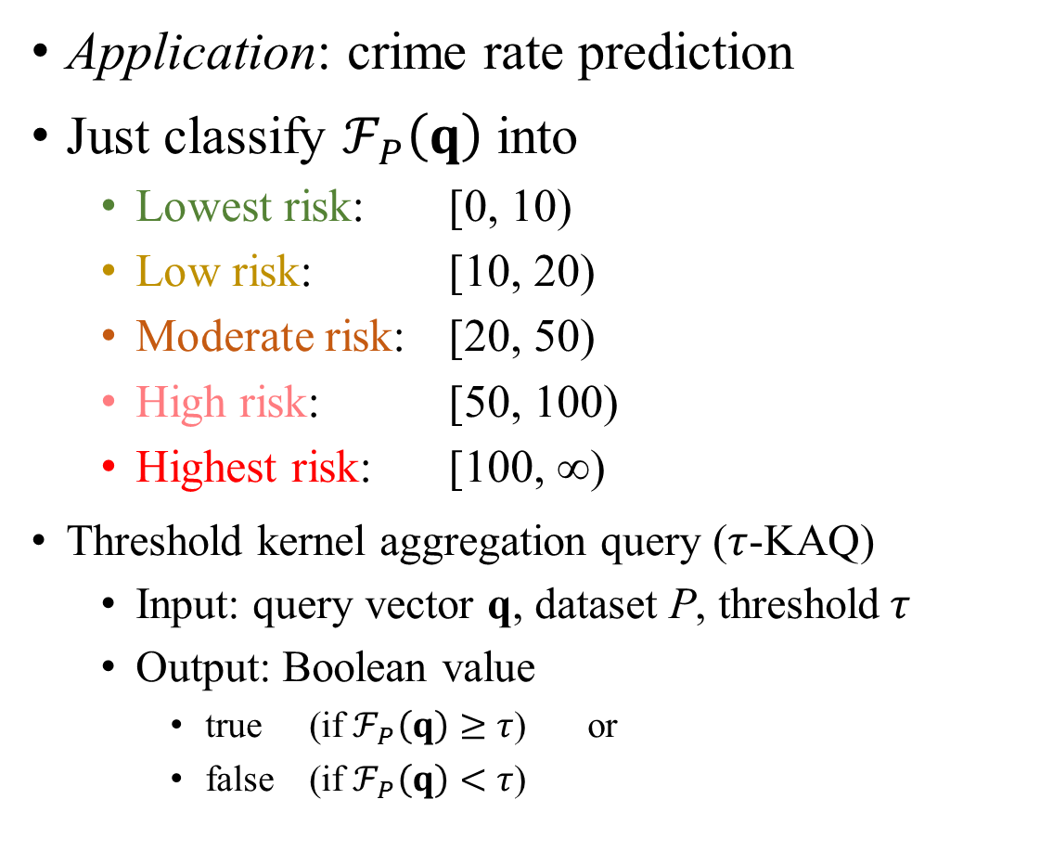
Kernel Aggregation Queries
Application: crime rate prediction
Just classify $ℱ_{P}\left(q\right)$ into
Lowest risk: [0, 10)
Low risk: [10, 20)
Moderate risk: [20, 50)
High risk: [50, 100)
Highest risk: [100, ∞)
Threshold kernel aggregation query ($τ$-KAQ)
Input: query vector q, dataset P, threshold$τ$
Output: Boolean value
true (if $ℱ_{P}\left(q\right)≥τ$) or
false (if $ℱ_{P}\left(q\right)<τ$)
T. Hart and P. Zandbergen “Kernel density estimation and hotspot mapping Examining the influence of interpolation method, grid cell size, and bandwidth on crime forecasting”, International Journal of Police Strategies and Management 2014

Slide 5
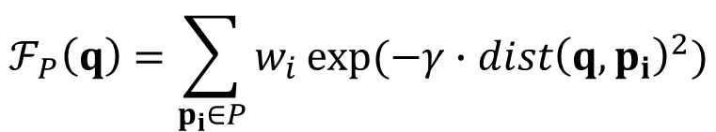
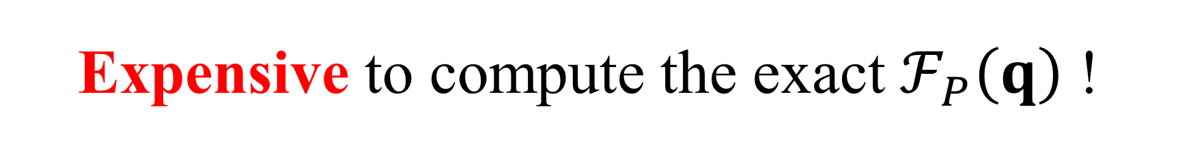
Expensive to compute the exact $ℱ_{P}\left(q\right)$ !
Le et al. “Despite their successes, what makes kernel methods difficult to use in many large scale problems is the fact that computing the decision function is typically expensive, especially at prediction time.” [1]
$$ℱ_{P}\left(q\right)=\sum_{p_{i}∈P}{w_{i}}exp⁡(−γ{∙dist\left(q,p_{i}\right)}^{2})$$
What are typical values of |P| and d?
O(|P| × d) time
[1] Quoc V. Le, Tamas Sarlos, and Alexander J. Smola. “Fastfood- computing hilbert space expansions in loglinear time.” In ICML2013

Slide 6
Our contribution: KARL
Kernel Aggregation Rapid Library (KARL)
2.5-738x speed up over state-of-the-art in different datasets
The Fastest library in online prediction phase
Library | Support indexing | Response time
LibSVM | no | high
Scikit-learn | yes | high
KARL (this paper) | yes | low
KARL: https://github.com/edisonchan2013928/KARL-Fast-Kernel-Aggregation-Queries
LibSVM: https://www.csie.ntu.edu.tw/~cjlin/libsvm/
Scikit-learn: https://scikit-learn.org/

Slide 7
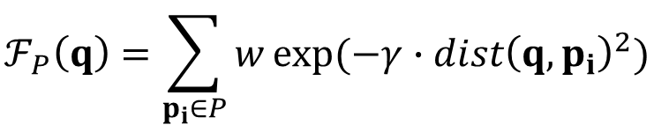




How to speed up?
$$ℱ_{P}\left(q\right)=\sum_{p_{i}∈P}{w}exp⁡(−γ∙{dist\left(q,p_{i}\right)}^{2})$$
Cases to avoid computing exact $ℱ_{P}\left(q\right)$:
Case 1 ($ℱ_{P}\left(q\right)≥\text{τ}$):
Case 2 ($ℱ_{P}\left(q\right)<\text{τ}$):
UB(q)
τ
$$LB\left(q\right)≤ℱ_{P}\left(q\right)≤UB(q)$$
UB(q)
LB(q)
τ
LB(q)
Requirements:
Fast to compute, e.g., O(d) time
As tight as possible

Slide 8
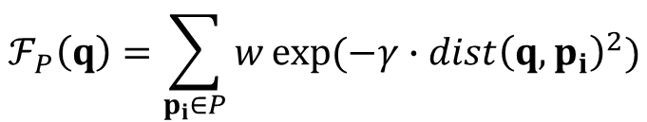
Existing Bounding Function
R
feature
space
maxdist(q,R)
$$ℱ_{P}\left(q\right)=\sum_{p_{i}∈P}{w}exp⁡(−γ{∙dist\left(q,p_{i}\right)}^{2})$$
q
x_{i}
$${LB}_{R}\left(q\right)=w∙R.count∙exp⁡(−γ{∙maxdist\left(q,R\right)}^{2})$$
x_{max}
distance
space
[1] "Scalable kernel density classification via threshold based pruning" SIGMOD2017
[2] “Nonparametric Density Estimation: Toward Computational Tractability” SDM03
x_{min}
x₁
x₂
Summary:
☑ Fast to compute, e.g., O(d) time
☒ Too loose
Too loose
x₃
x_{max}
function
exp(–x)
existing bound:
exp(-x_{max})

Slide 9
Research question 1:
How to develop a tighter lower bound function (than the existing one)?
x_{min}
x₁
x₂
Too loose
x₃
x_{max}
function
exp(–x)
existing bound:
exp(-x_{max})

Slide 10
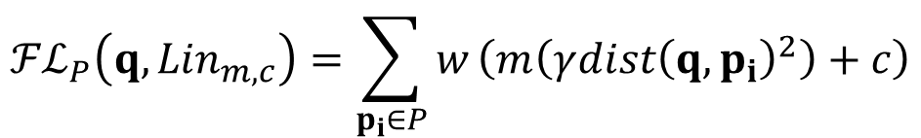
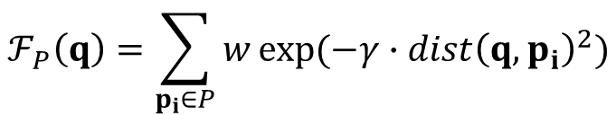
Our Idea: Tangent Bound
$$ℱ_{P}\left(q\right)=\sum_{p_{i}∈P}{w}exp⁡(−γ{∙dist\left(q,p_{i}\right)}^{2})$$
x_{i}
x_{min}
Tangent Bound:
the tangent line (at x_{max}):
E^{L}(x) = mx + c
x₁
$${ℱℒ}_{P}\left(q,{Lin}_{m,c}\right)=\sum_{p_{i}∈P}{w}\left(m\left(γ{dist\left(q,p_{i}\right)}^{2}\right)+c\right)$$
x₂
x₃
function
exp(–x)
x_{i}
x_{max}
☺ always tighter than the existing bound
existing bound:
exp(-x_{max})
Research question 2:
How to compute this tighter bound quickly?

Slide 11
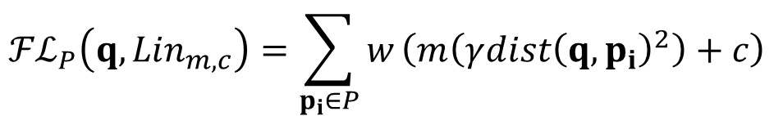
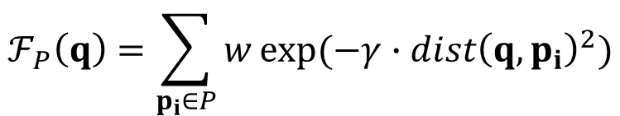
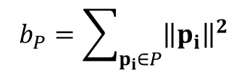
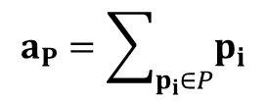
O(d)-time Tighter Linear Bound
$$ℱ_{P}\left(q\right)=\sum_{p_{i}∈P}{w}exp⁡(−γ{∙dist\left(q,p_{i}\right)}^{2})$$
Tightness
Exact
x_{i}
Linear bound of $ℱ_{P}\left(q\right)$:
$${ℱℒ}_{P}\left(q,{Lin}_{m,c}\right)=\sum_{p_{i}∈P}{w}\left(m\left(γ{dist\left(q,p_{i}\right)}^{2}\right)+c\right)$$
Ours
x_{i}
Existing bounds
$${ℱℒ}_{P}\left(q,{Lin}_{m,c}\right)=wmγ\left(\left|P\right|{\left\|q\right\|}^{2}−2q∙a_{P}+b_{P}\right)+wc|P|$$
Time
O(d)
O(|P|d)
O(d)
O(d)
where
$$a_{P}=\sum_{p_{i}∈P}{p_{i}}$$
and
$$b_{P}=\sum_{p_{i}∈P}{{\left\|p_{i}\right\|}^{2}}$$

Slide 12
Research question 3:
How to further tighten our bound (tangent bound)?
x_{min}
the tangent line (at x_{max}):
E^{L}(x) = mx + c
x₁
Too loose
x₂
x₃
x_{max}
function
exp(–x)
existing bound:
exp(-x_{max})

Slide 13
Observation: The optimal tangent line depends on the distance values (e.g., x₁, x₂, x₃)
x_{min}
x₁
x₂
x₃
x_{max}
function
exp(–x)
optimized tangent line (at t):
E^{L}(x)=mx + c
Challenge: How to compute the optimal tangent efficiently (e.g., O(d) time) without knowing the exact distance values (e.g., x₁, x₂, x₃)?
Solved in our paper

Slide 14
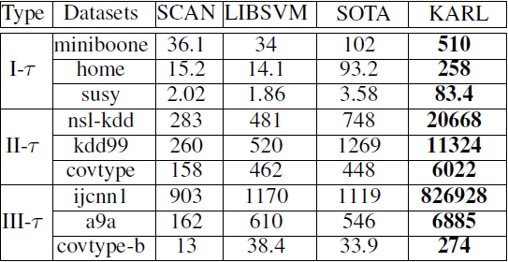
Experimental Results
Methods: SCAN (baseline), LIBSVM, SOTA and KARL
Datasets: UCI Machine Learning Repository/ LibSVM website
Throughput (Queries/sec)
SOTA: E. Gan and P. Bailis. "Scalable kernel density classification via threshold based pruning" SIGMOD2017

Slide 15
Conclusion and Future Work
What we have done:
Develop Kernel Aggregation Rapid Library (KARL)
Support a wide range of models (in prediction stage)
Kernel Density Classification
One Class SVM
Two Class SVM
Achieve higher throughput than the state-of-the-art by 2.5-738x times
Future Work:
Integrate the implementation into the library (Ongoing)
Support different types of machine learning models (Ongoing)
Support different types of kernel functions (Ongoing)
Support interesting applications, e.g., Kernel Density Visualization (Ongoing)

Slide 16
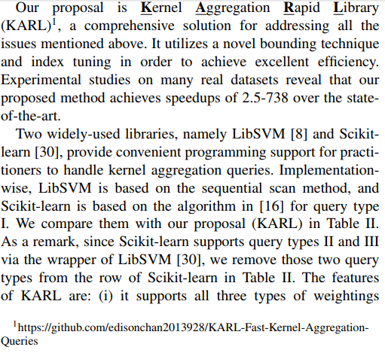
For more details…
The Github page is in Page 2 of our paper

